Slide 1
How to create thread
An application that creates an instance of Thread must provide the code that will run in that thread.
There are two ways to do this.
Thread class
By extending Thread class
Runnable interface.
By implementing Runnable interface.

Slide 2
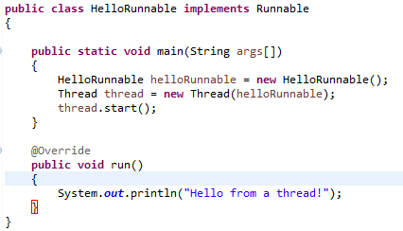
How to create thread
Provide a Runnable object.
The Runnable interface defines a single method, run, meant to contain the code executed in the thread. The Runnable object is passed to the Thread constructor, as in the HelloRunnable example:
Invoke Thread.start in order to start the new thread.

Slide 3
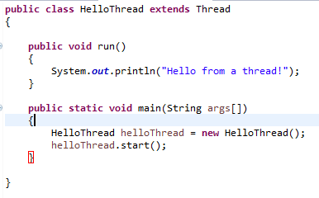
How to create thread
Subclass Thread. The Thread class itself implements Runnable, though its run method does nothing. An application can subclass Thread, providing its own implementation of run, as in the HelloThread example:
Invoke Thread.start in order to start the new thread.

Slide 4
How to create thread
Which of these idioms should you use?
The first idiom, which employs a Runnable object, is more general, because the Runnable object can subclass a class other than Thread. This approach separates the Runnable task from the Thread object that executes the task. Not only is this approach more flexible, but it is applicable to the high-level thread management APIs
The second idiom is easier to use in simple applications, but is limited by the fact that your task class must be a descendant of Thread.

